Slide 1



PHP CrashCourse
PHP
Presented by Eng. Ramy Ibrahim
+20 10 928 128 48– ramymibrahim@yahoo.com

Slide 2
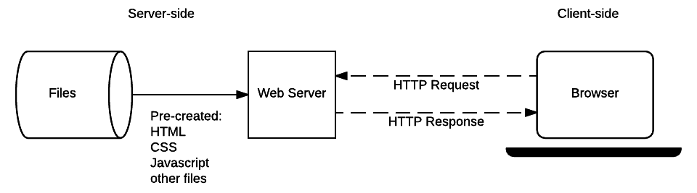
How web works
The complete story

Slide 3
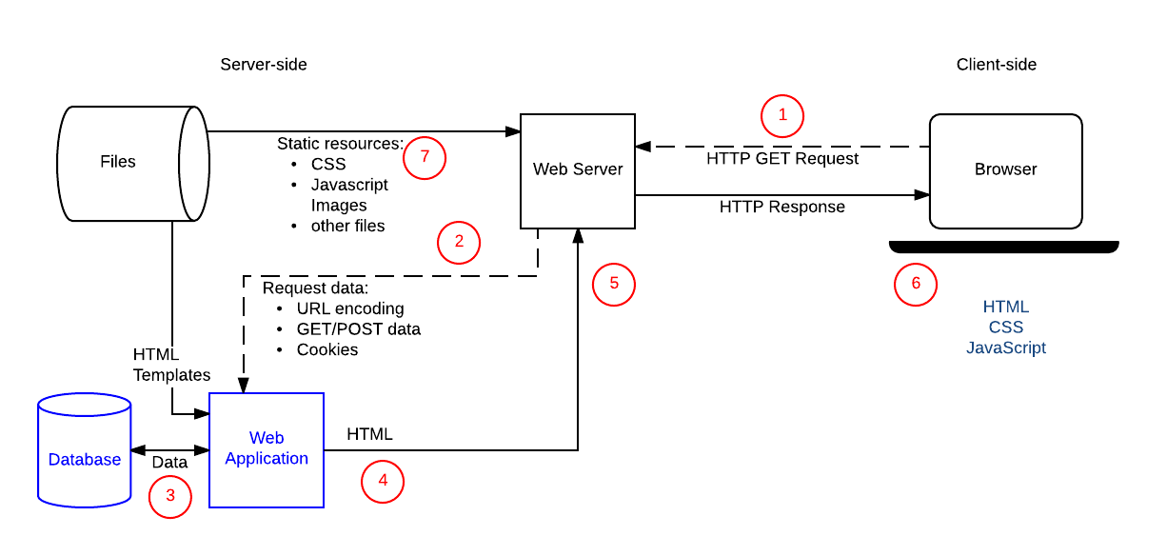
How web works
Complete story
Client – Server architecture
Protocols
URL
Methods

Slide 4
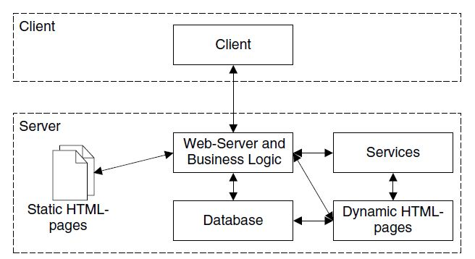
What is Client / Server

Slide 5
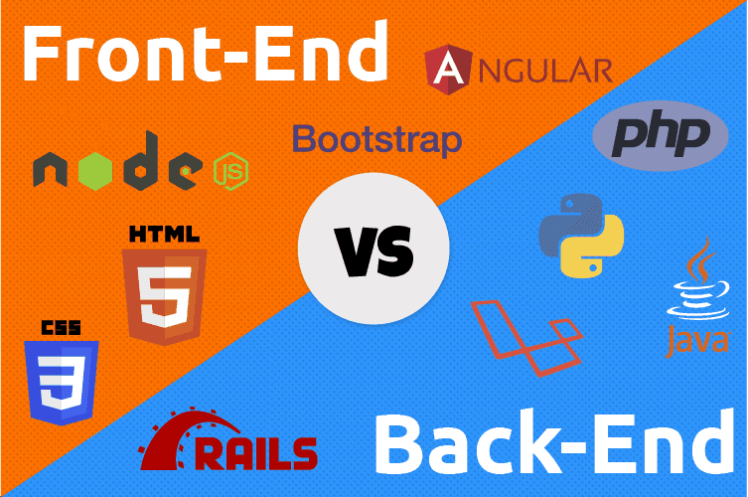
Front, Back end

Slide 6
What is Client / Server

Slide 7
What is PHP ?
PHP stands for PHP; Hypertext processor (Personal Homepage tools)
Server-side language same as ASP
Interpreted & Compiled
Single threaded
Open Source
Support Many DB (mainly MySQL)

Slide 8
Web Server
Apache server
IIS
WAMP (Windows, Apache, MySQL and PHPMyAdmin)
LAMP (Linux, Apache, MySQL and PHPMyAdmin)
MAMP (Mac OS, Apache, MySQL and PHPMyAdmin)
XAMP (X platform, Apache, MySQL and PHPMyAdmin)

Slide 9
PHP Features
CRUD data from database
File handling
Can collect form data
PHP handles Session and Cookies
PHP can encrypt and decrypt data
PHP is a Dynamic typed language

Slide 10
PHP Syntax
<?php ?>
Close or not
echo
<?= ?>
Escaping from HTML
Comments

Slide 11
Datatypes
Bool
Int
Float (aka double)
String
Array
Object

Slide 12
Variables
$
Variable names start with _ or a-z
Variable string can contain _ or a-z or 0-9 only
Meaningful names (_ or camel case)
Super global variables
$GLOBALSE
$_SESSION,$_COOKIES
$_GET,$_POST,$_REQUEST
$_SERVER
$_ENV
$_FILES

Slide 13
Debugging
Var_dump
Var_export
die

Slide 14
Type functions & Casting
Gettype
Settype
Is_set
Un_set
Is_int
Is_float
is_string
Is_bool
casting

Slide 15
Falsely values
False
0
0.0
-0.0
“0”
[]
“”
Null
All other values are true even (empty resource and NAN)

Slide 16
Operators
Arithmetic
Assignment
Comparison
Logical Operators
Array Operators
Union (+)
Equality (==,!=,<>)
Identity (===,!==)

Slide 17
Conditional statements
If
If else
If else if else
Switch

Slide 18
Loops
For
While
Do While
Foreach of

Slide 19
Arrays
Indexed
Associative
Multi-dimensional
Array functions
Count
Sort,rsort
Asort,arsort
Ksort,krsort

Slide 20
Form tag
GET
URL params, max character length 2000
POST
Hidden params, can send files
Enctype=“multipart/formdata”
Validation (server side)
Empty
Is_set
htmlspecialchars

Slide 21
Functions
Functions are not case-sensitive
Function parameters & optional parameters
Pass by value and pass by reference

Slide 22
Datetime
$time_input = strtotime("2011/05/21");
$date_input = getDate($time_input);
echo strtotime("now"), "\n";
echo strtotime("10 September 2000"), "\n";
echo strtotime("+1 day"), "\n";
echo strtotime("+1 week"), "\n";
echo strtotime("+1 week 2 days 4 hours 2 seconds"), "\n";
echo strtotime("next Thursday"), "\n";
echo strtotime("last Monday"), "\n";

Slide 23
Datetime
Dates in the m/d/y or d-m-y formats are disambiguated by looking at the separator between the various components: if the separator is a slash (/), then the American m/d/y is assumed; whereas if the separator is a dash (-) or a dot (.), then the European d-m-y format is assumed. If, however, the year is given in a two digit format and the separator is a dash (-), the date string is parsed as y-m-d.
To avoid potential ambiguity, it's best to use ISO 8601 (YYYY-MM-DD) dates or DateTime::createFromFormat() when possible.

Slide 24
Datetime
$today = date("F j, Y, g:i a"); // March 10, 2001, 5:16 pm
$today = date("m.d.y"); // 03.10.01
$today = date("j, n, Y"); // 10, 3, 2001
$today = date("Ymd"); // 20010310
$today = date('h-i-s, j-m-y, it is w Day'); // 05-16-18, 10-03-01, 1631 1618 6 Satpm01
$today = date('\i\t \i\s \t\h\e jS \d\a\y.'); // it is the 10th day.
$today = date("D M j G:i:s T Y"); // Sat Mar 10 17:16:18 MST 2001
$today = date('H:m:s \m \i\s\ \m\o\n\t\h'); // 17:03:18 m is month
$today = date("H:i:s"); // 17:16:18
$today = date("Y-m-d H:i:s"); // 2001-03-10 17:16:18 (the MySQL DATETIME format)

Slide 25
Files
echo readfile(“file.txt");
$myfile = fopen("file.txt", "r") or die("Unable to open file!");
echo fread($myfile,filesize(" file.txt"));
fclose($myfile);
while(!feof($myfile)) {
echo fgets($myfile) . "<br>";
}

Slide 26
Files
r | Open a file for read only. File pointer starts at the beginning of the file
w | Open a file for write only. Erases the contents of the file or creates a new file if it doesn't exist. File pointer starts at the beginning of the file
a | Open a file for write only. The existing data in file is preserved. File pointer starts at the end of the file. Creates a new file if the file doesn't exist
x | Creates a new file for write only. Returns FALSE and an error if file already exists
r+ | Open a file for read/write. File pointer starts at the beginning of the file
w+ | Open a file for read/write. Erases the contents of the file or creates a new file if it doesn't exist. File pointer starts at the beginning of the file
a+ | Open a file for read/write. The existing data in file is preserved. File pointer starts at the end of the file. Creates a new file if the file doesn't exist
x+ | Creates a new file for read/write. Returns FALSE and an error if file already exists

Slide 27
Files
echo readfile(“file.txt");
$myfile = fopen("file.txt", "r") or die("Unable to open file!");
echo fread($myfile,filesize(" file.txt"));
fclose($myfile);
while(!feof($myfile)) {
echo fgets($myfile) . "<br>";
}

Slide 28
Files
$myfile = fopen("newfile.txt", "w") or die("Unable to open file!");
fwrite($myfile, ‘line1’);
fclose($myfile);

Slide 29

Complete site

Slide 30
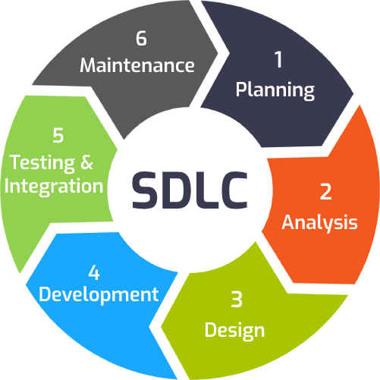
Building Blog website (SDLC)
SDLC
Analysis
Design
Implementation
Testing
Traditional vs Modern
User stories

Slide 31
Traditional SDLC methodologies
Waterfall model
Analysis
Design
Implementation
Testing
V model
Unit testing
Integration testing
Acceptance testing
Stress testing

Slide 32
Modern SDLC methodologies
Agile

Slide 33
Building HTML templates with external scripts
Include
Include_once
Require
Require_once

Slide 34
Database concepts
File example
Spread sheet example
Data consistency
Data security
Data sharing
Search problem (seek vs search)
Multi-user problem
RDMS
PHPMYADMIN

Slide 35
DB Relations
One – One
One – Many
Many - Many

Slide 36
Database concepts
ERD
CAP theorem
Relational vs no-SQL database
Data Definition Language (DDL)
Data Manipulation Language (DML)

Slide 37
Database (DML)
Insert
Update
Delete
Select
Where
Group-by
Aggregate functions

Slide 38
MYSQLi and PDO
MySQLi OOP (Improved)
MySQLi Procedural
PDO

Slide 39
MySQLi OOP
<?php $servername = "localhost"; $username = "username"; $password = "password"; // Create connection $conn = new mysqli($servername, $username, $password); // Check connection if ($conn->connect_error) { die("Connection failed: " . $conn->connect_error); } echo "Connected successfully";
$conn->close(); ?>

Slide 40
MySQLi Procedural
<?php $servername = "localhost"; $username = "username"; $password = "password"; // Create connection $conn = mysqli_connect($servername, $username, $password); // Check connection if (!$conn) { die("Connection failed: " . mysqli_connect_error()); } echo "Connected successfully";
mysqli_close($conn); ?>

Slide 41
PDO (PHP Data Object)
https://www.php.net/manual/en/pdo.installation.php
<?php $servername = "localhost"; $username = "username"; $password = "password"; // Create connection $conn = mysqli_connect($servername, $username, $password); // Check connection if (!$conn) { die("Connection failed: " . mysqli_connect_error()); } echo "Connected successfully";
$conn = null; ?>

Slide 42
Insert Data
if ($conn->query($sql) === TRUE)
if (mysqli_query($conn, $sql))
$conn->exec($sql);
$conn->multi_query($sql)
if (mysqli_multi_query($conn, $sql))
$conn->beginTransaction();Exec then $conn->commit();

Slide 43
Get last Id
$last_id = $conn->insert_id;
$last_id = mysqli_insert_id($conn);
$last_id = $conn->lastInsertId();

Slide 44
SQL Injection & Prepared statements
$stmt = $conn->prepare("INSERT INTO MyGuests (firstname, lastname, email) VALUES (?, ?, ?)"); $stmt->bind_param("sss", $firstname, $lastname, $email);
Set var values then
$stmt->execute(); $stmt->close(); $conn->close();
i - integer
d - double
s - string
b - BLOB

Slide 45
Multi-tier application
Presentation
Data Access
Logic

Slide 46
Building Blog
SDLC
User stories
DB design
Implementation
Implement navigation
Implement authentication and authorization
Session and Cookies (save password)
Implement APIs
Testing
Application
APIs

Slide 47
OOP
Abstraction
Encapsulation
Inheritance
Polymorphism
Static classes and functions

Slide 48
Make it clean
Single responsibility principle
Make it Object oriented
Make it multi-tier
Make it secure
SQL injection
XSS injection

Slide 49
Laravel
MVC
Why Laravel ?
Convert native PHP application to Laravel

